Slide 1

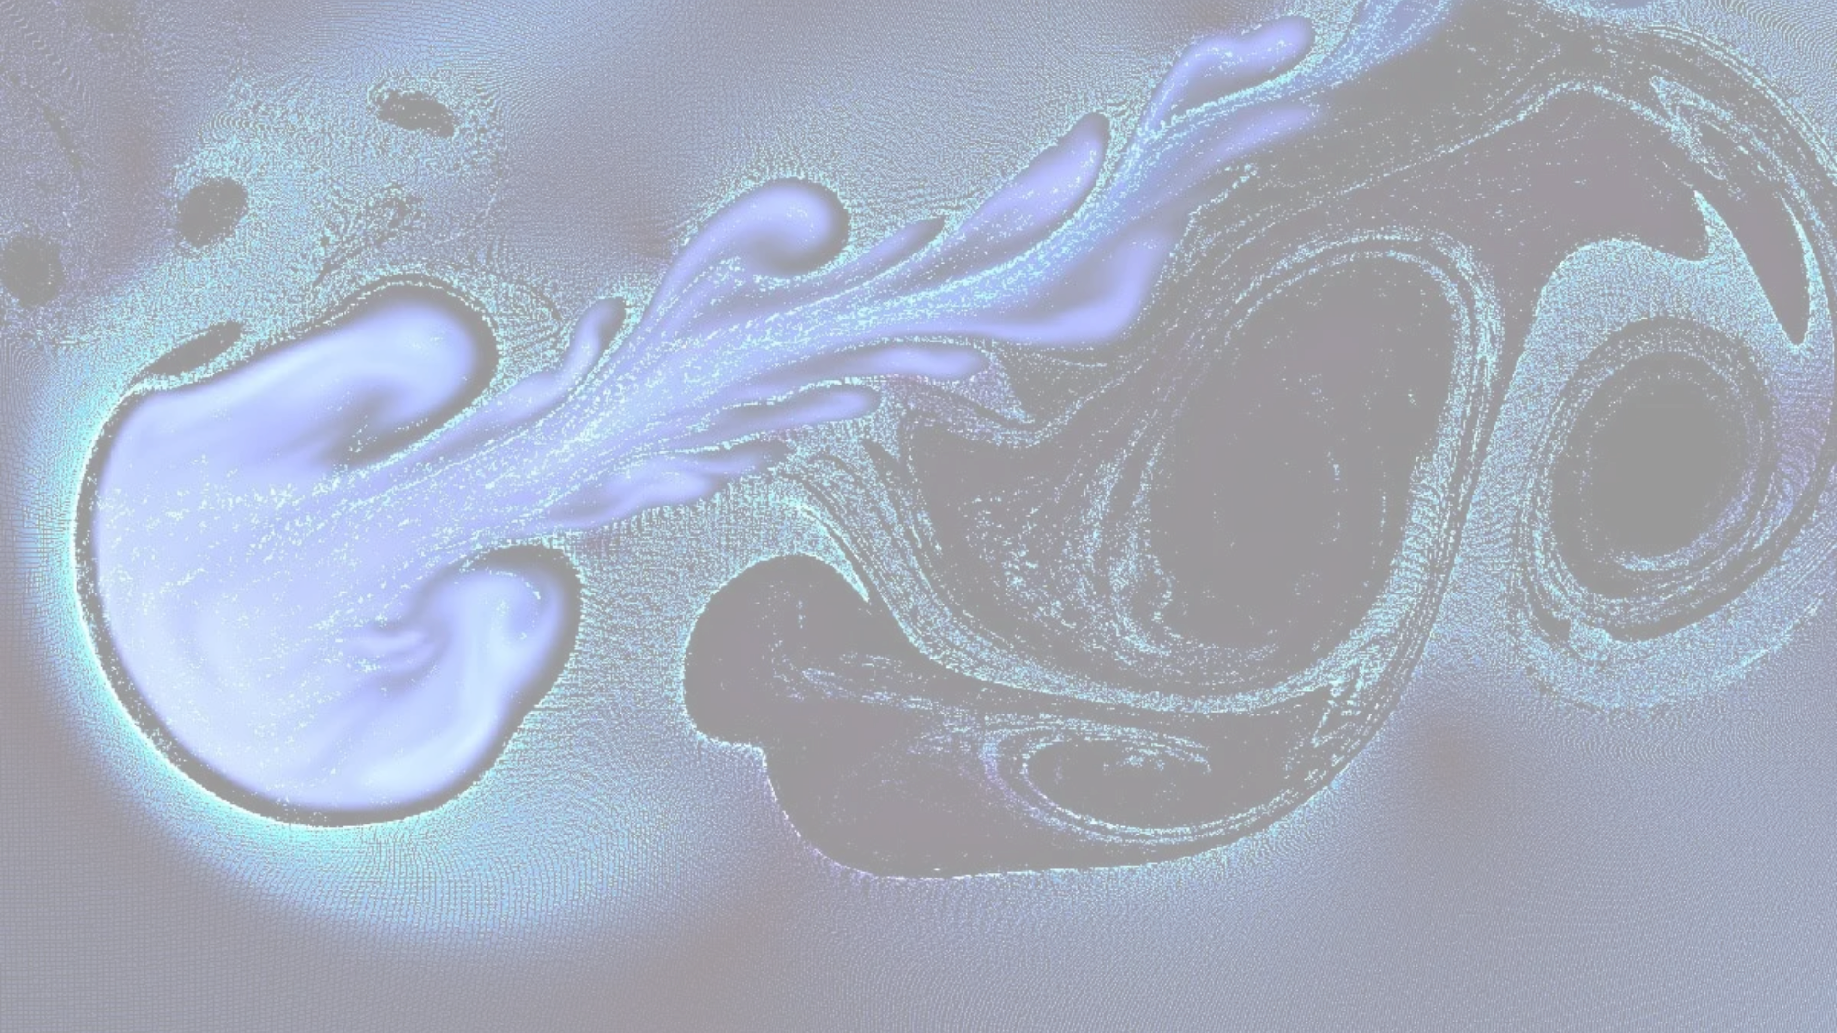










Ephemeral Time
An Ink Clock
A visual representation of time's passage through ink droplets that fall and blend, creating traces of elapsed time rather than precise measurement
Impermanence & Trace
Accumulation
Subjective Flow

Slide 2













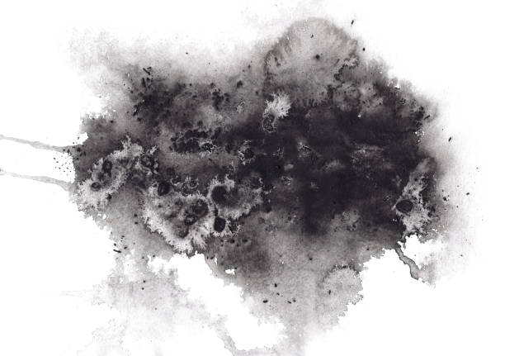







Ephemeral Time : An Ink Clock
Core Idea
Time Display
My Concept
A project that visualizes the traces of elapsed time through a visual experience where drops of ink fall and spread on a canvas every second.
The goal is not to serve as a precise timekeeping device, but to provide an experience that allows users to directly feel the flow of time and the accumulation of memories.
Seconds
A tiny little drop
Minute
A normal size of drop
Hours
Subject
A giant single drop covers the stains canvas
Days
Impermanence
Accumulation
Subjective Flow
Canvas resets, but shows ink drops how many days passed
The ink may disperse, but its traces remain.
The visual complexity grows as time passes.
An experience that lets you feel the texture and passage of time.

Slide 3








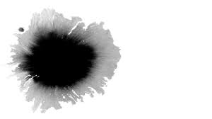

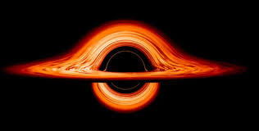
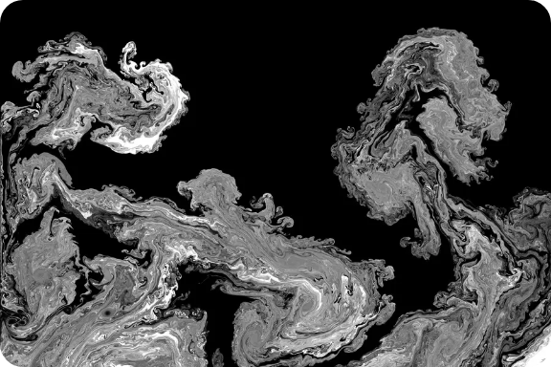
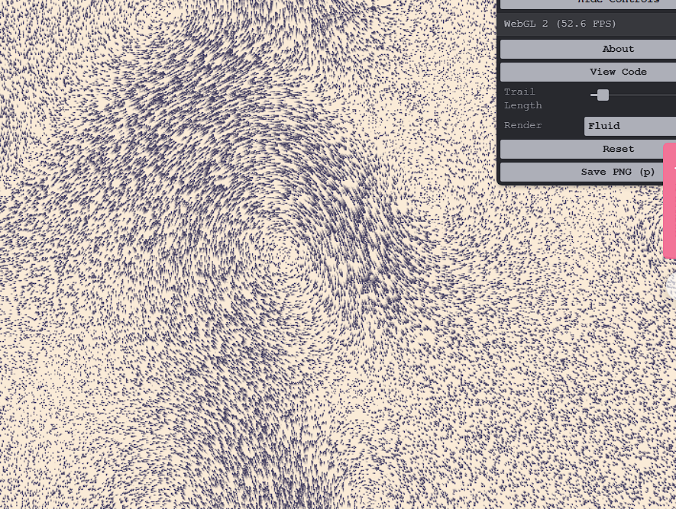







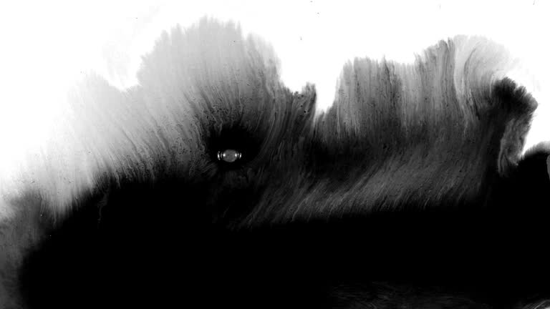
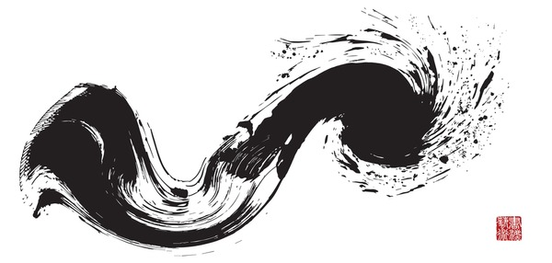



Ephemeral Time : An Ink Clock
Visual Reference
References
Technology
Fluid Simulation
Music / Movies
p5.js: Interactive Arts
Expressing the traces left by people over time through ink. Idea inspirations from
Personal experience and the music what I like
(Event horizon [yoonha], Gate of Steiner)
Creative Coding Based Arts
Abstract and organic visual patterns are generated algorithmically, evolving over time. The design is inspired by time-based changes, including increasing complexity of ink patterns and color-shifting logic as time progresses.
Interactive artwork with spreading paint effects
Visual effects of paint spreading in response to user input. Serves as a reference for implementing ink flow and shape changes based on mouse interactions.
Sound Design
p5.Sound/Tone.js
Mouse Interaction
Every drop (seconds) makes a drop sound.
It can control the where next drop should be, but limitation so that it shows time passes whether you want it to go faster or not
Seconds: a drop sounds
Time passes: ambient sounds

Slide 4







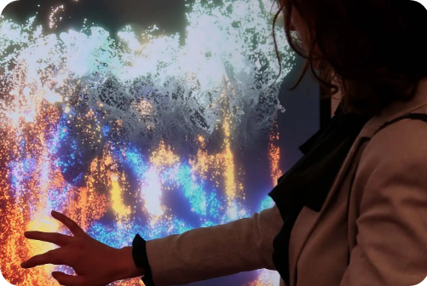





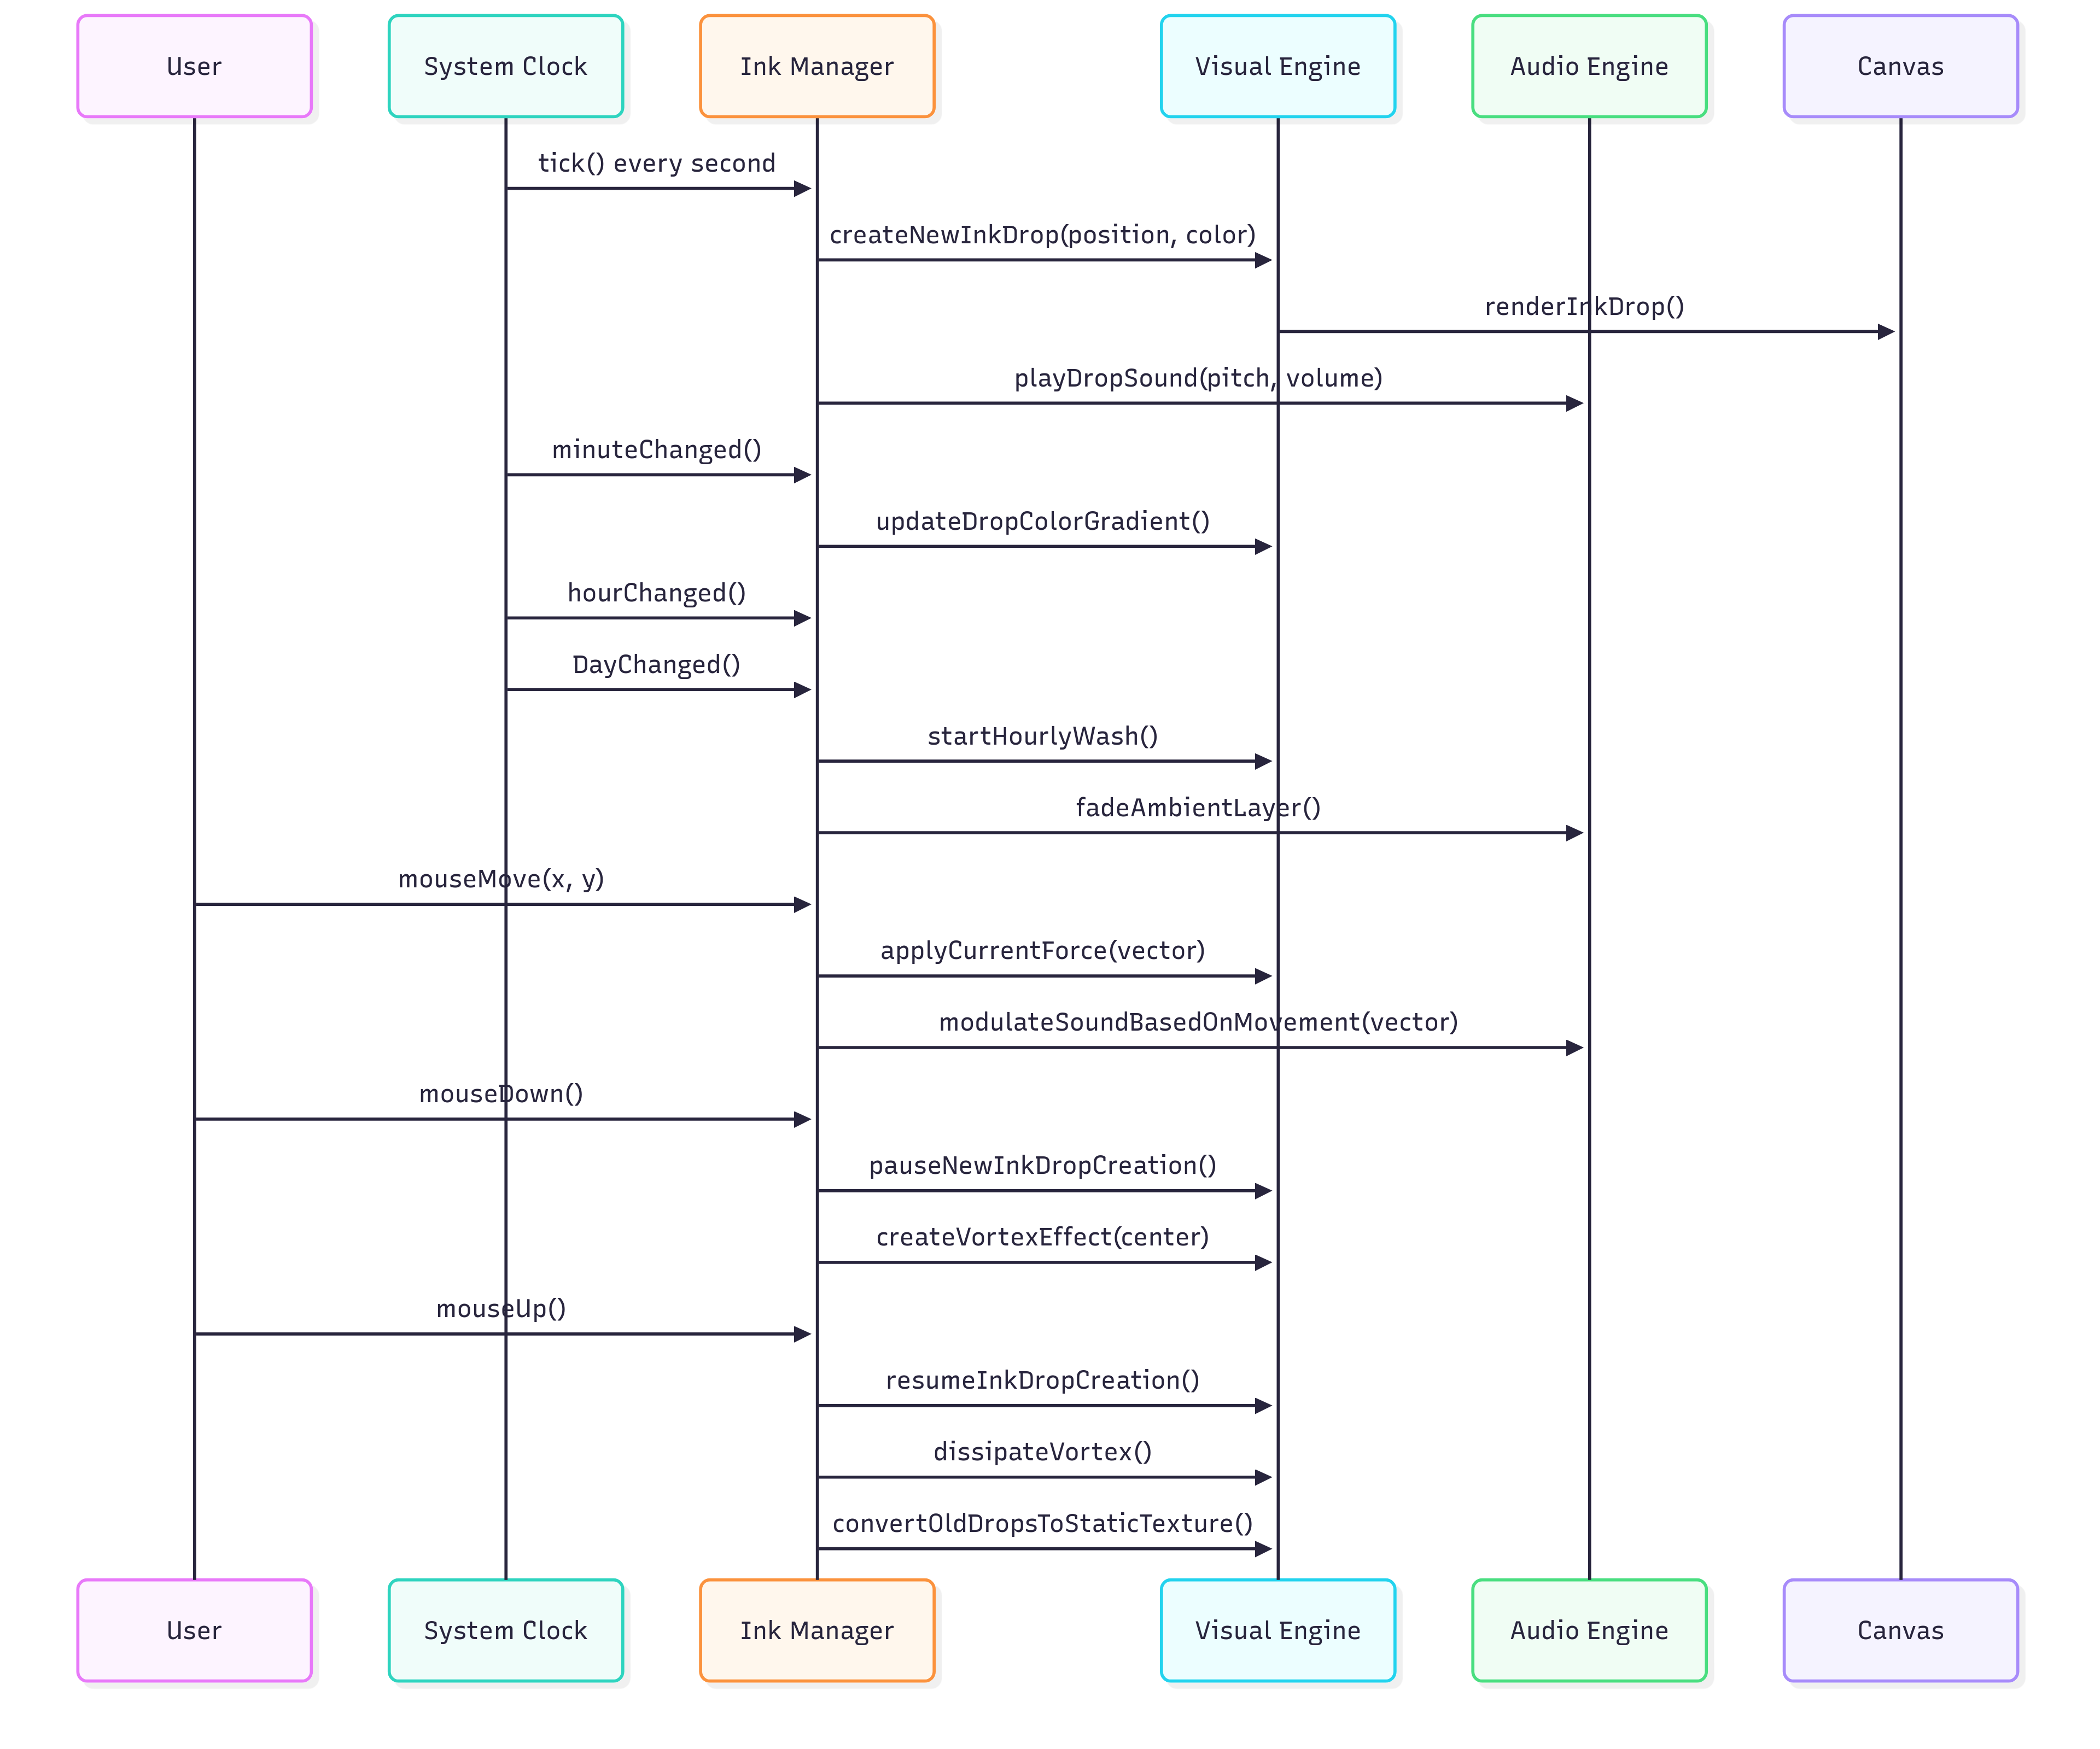
Implementation Plan
User Interaction
It pauses for one second, which itself takes one second.
Development Time line
Mouse Movement
Click & Holds
Week | Milestone / Task
Week 1 | Concept & Setup → Finalize core idea, sketches, references. Set up project repo and environment (WebGL / p5.js).
Week 2 | Prototype → Implement ink drop system (shader/particles), link to real clock time, test basic visuals.
Week 3 | Interaction & Optimization → Add user interaction (mouse/touch ripples), audio sync. Optimize performance (particle cap, static background).
Week 4 | Polish & Presentation → Add UI hints, handle accessibility, test on multiple devices, prepare demo and presentation materials.
Moving the mouse across the canvas creates the flow of ink drops, which also influences the spatial feel and rhythm of the background sound.
Clicking the mouse temporarily pauses the creation of new ink drops and generates swirling effects from the existing drops.
Risk & Mitigation
Sequence Diagram
Risk
Mitigation
Performance slowdown due to too many ink drops accumulating and overloading GPU/CPU | Optimize shaders, convert old ink into static background textures, and cap maximum particle count.
User confusion about interaction or not realizing it is a “clock” | Provide subtle visual hints (ripples, tooltips), keep interactions intuitive, and optionally overlay minimal time markers.
Visual clutter making the display unreadable over time | Implement gradual fading, alpha blending, and a periodic “daily wash” reset to maintain clarity.

Slide 5
References
Shutterstock. (n.d.). 18+ thousand Asian ink drop [Stock images]. Shutterstock. https://www.shutterstock.com
Gate of Steiner. (n.d.). Gate of Steiner [Video]. YouTube. https://www.youtube.com/watch?v=hzPg6CZj4Yg
Younha. (2025). 사건의 지평선 [Music video]. YouTube. https://www.youtube.com/watch?v=BBdC1rl5sKY
Sundftig. (n.d.). Fluid simulation 2 [Computer software/sketch]. p5.js Web Editor.
Retrieved September 30, 2025, from https://editor.p5js.org/Sundftig/sketches/Nx4gQsewQ

